Slide 1



Ionic sepintas lalu
khirulnizam.com

Slide 2

Schedule
Day1: Intro to Ionic, HTML Angular,
Tabs, Cards Layout, Buttons, Labels, Inputs
TypeScript: pembolehubah, sintaks
If..else in typescript & angular
Repetition
Functions in Typescript
Page navigation
Day2: Online database with Firebase

Slide 3
OVERVIEW
TO IONIC FRAMEWORK

Slide 4
What is Ionic?
Ionic Framework is an open source UI toolkit for building performant, high-quality mobile and desktop apps using web technologies (HTML, CSS, and JavaScript).

Slide 5
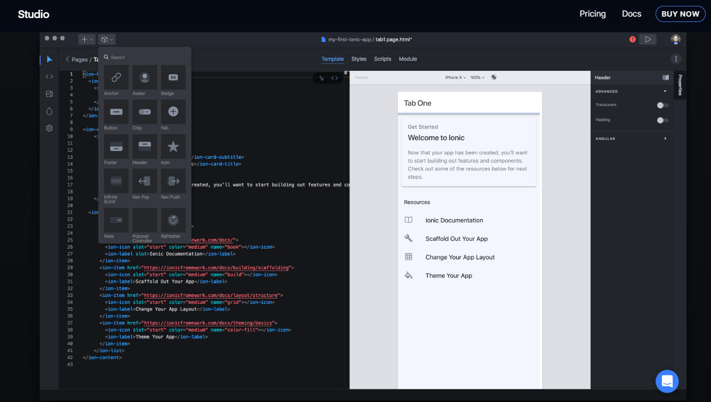
IonicX

Slide 6
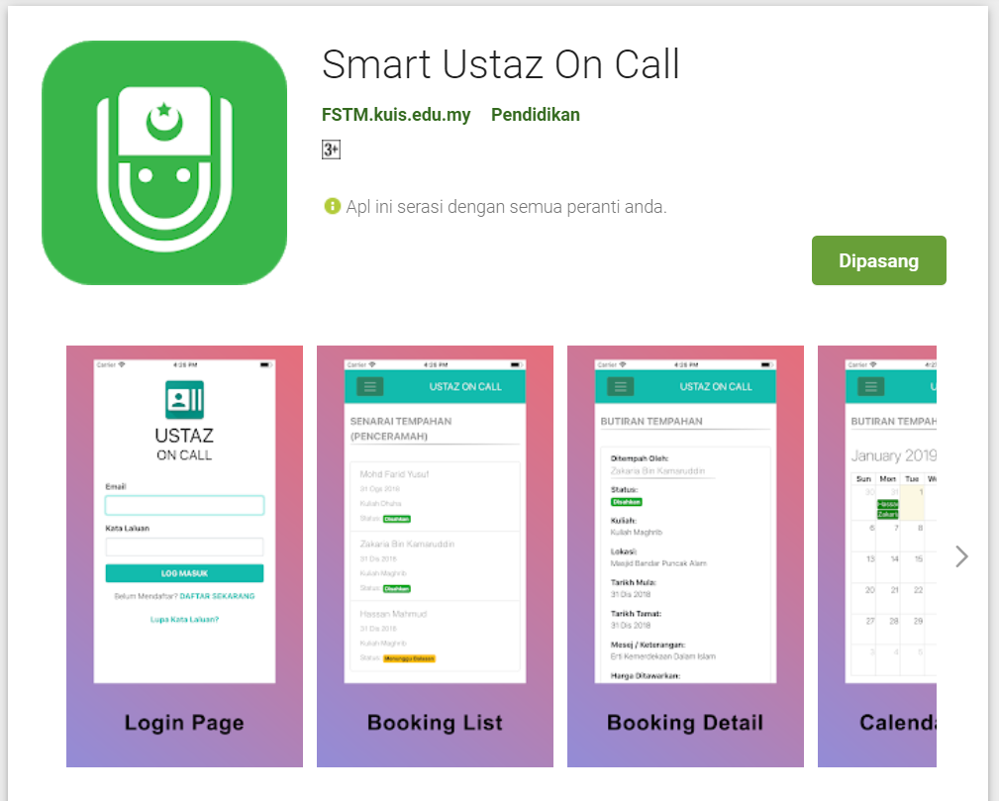
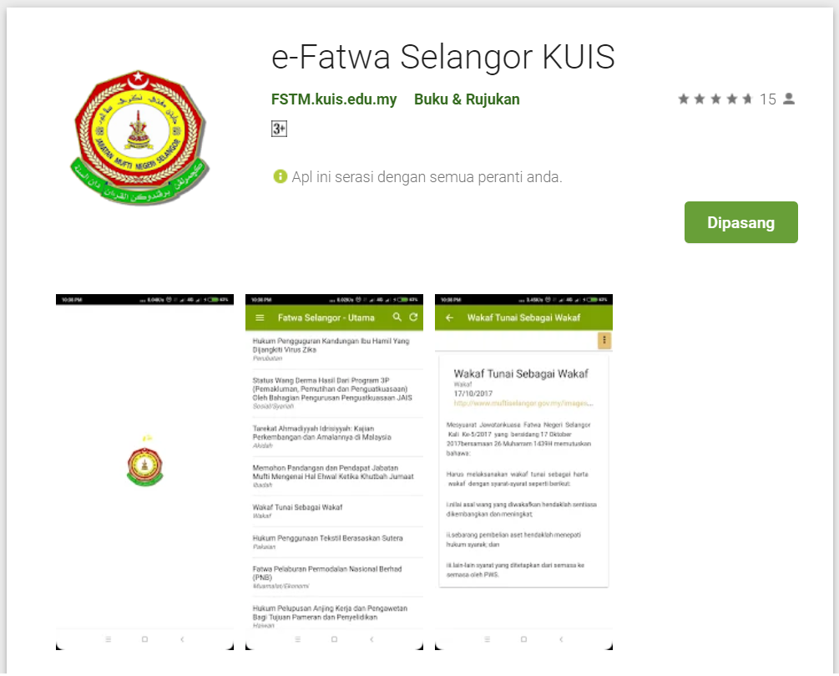
Available apps

Slide 7
IOS & Android Software Development
In a nutshell

Slide 8





Android Studio
(Java & Kotlin)
Android Device
NATIVE - 2 X WORK
XCode (Swift & Objective C)
iPhone/iPad

Slide 9

1 x WORK
Compile with Android SDK
Android Device
Cordova + Capacitor
Hybrid
XCode Project
iPhone/iPad

Slide 10
Cordova
Framework
Hybrid
WEB LAYER
NATIVE APP

Slide 11
1 x WORK
Build Progressive Web Apps
Android Device
Build Progressive Web Apps
Cordova
Framework
Hybrid
iPhone/iPad

Slide 12


1 x WORK
Android Studio
Android Device
+
XCode
iPhone/iPad

Slide 13
https://capacitor.ionicframework.com/

Slide 14



WHY IONIC?
Framework specifically to develop apps
Multiple platforms-Android, IOS, Windows, Amazon etc
Apps development using HTML & Typescript (subset of Javascript)
Plugins (camera, thumbprint, bluetooth, printer etc etc etc)

Slide 15
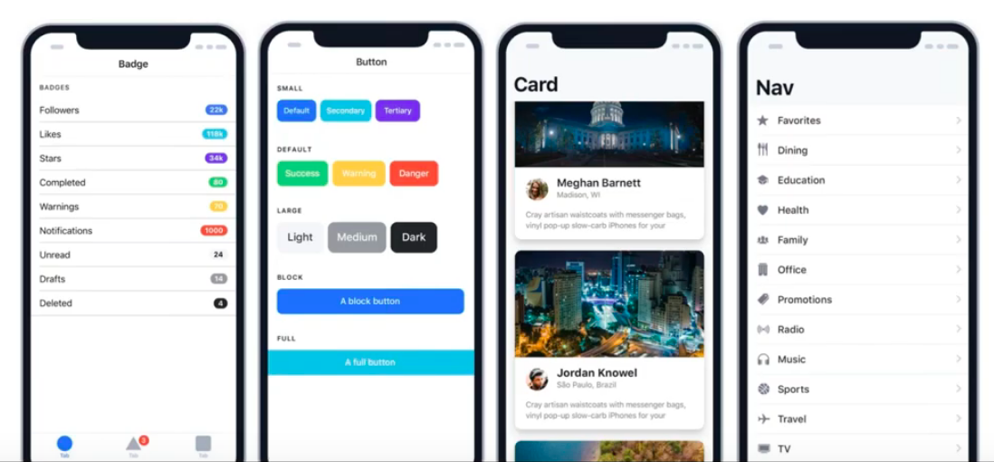
WHY IONIC?
Large COMMUNITY for support
Pre built gestures & animation
100+ UI Components
Everything is OPEN SOURCE
Built with Ionic

Slide 16
Software to start Ionic?

Slide 17
What do you need?
To run IONIC:
Node Package Manager (NPM)
Ionic Cordova Framework
Google Chrome Web Browser
To develop/publish app
VSCode OR any other IDE (with Typescript Plugin)
Ionic Capacitor
Android SDK or Xcode - can be done later

Slide 18

Download from nodejs.org
Download and install the NODEJS LTS version 14
http://nodejs.org

Slide 19
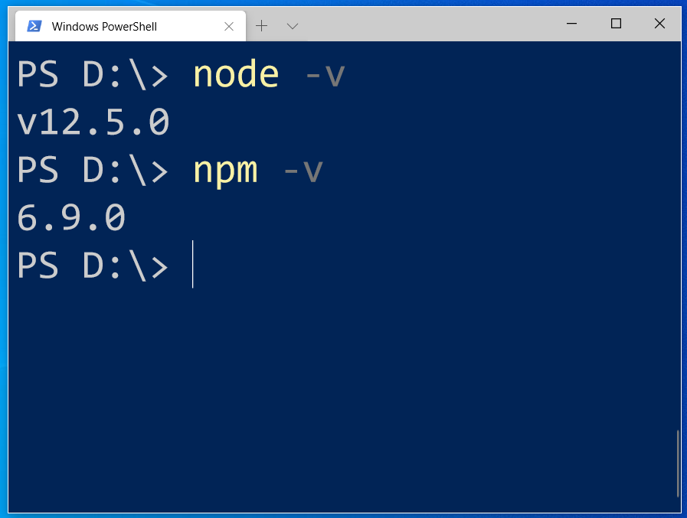
After install NodeJS from nodejs.org
node -v
npm -v

Slide 20
2. From command terminal run:
npm install -g @ionic/cli

Slide 21
Now, let’s install the tools

Slide 22
Install VSCode/sublime
NodeJS
Tutorial is here bit.ly/ionickerul
Install Google Chrome Browser
(If you don’t have, you should)

Slide 23
Before we start coding, some basic stuff...

Slide 24
-HTML?
-CSS ?
-TypeScript ?

Slide 25
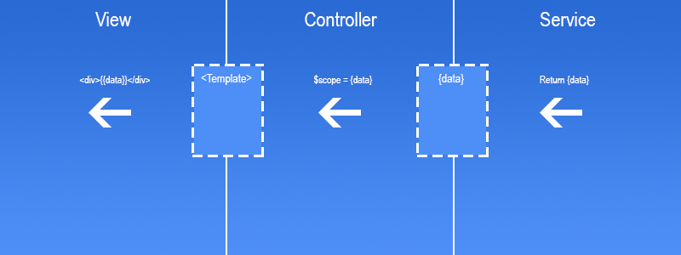
Simple MVC in Ionic
.HTML | .TS | services .TS /Model

Slide 26
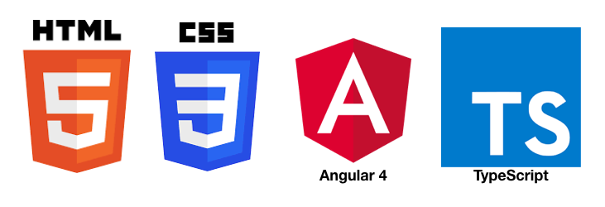
HTML
-Hyper Text Mark Up Language (HTML)
-Used to display the interface
-Write in tags,
-Example- <strong>Hello</strong> → Hello
-Ionic has its own built in tags
<ion-list></ion-list>
<ion-item></ion-item>
<ion-grid></ion-grid>
-HTML in Ionic is “AngularJS Flavoured”
-Have to use Angular Syntax for data and clicks
-Example- (click), *ngFor etc

Slide 27
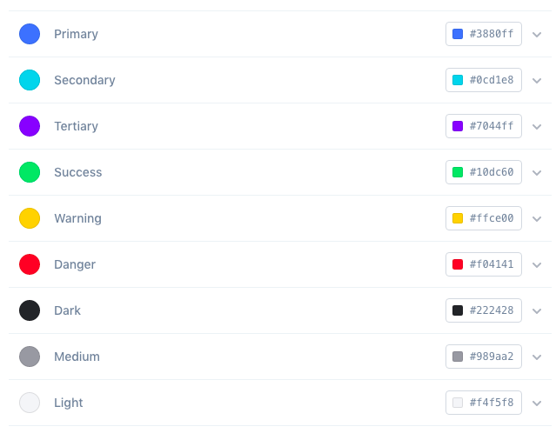
CSS or SCSS
-Cascading Style Sheets (CSS)
-Used for styling, very straightforward
-Each generated Ionic page comes with built in own CSS
-Can assist in ‘theming’ the app
-Ionic has standard built in colours
-Primary, Secondary, Danger, Light & Dark
Built in colours that can be added/edited

Slide 28
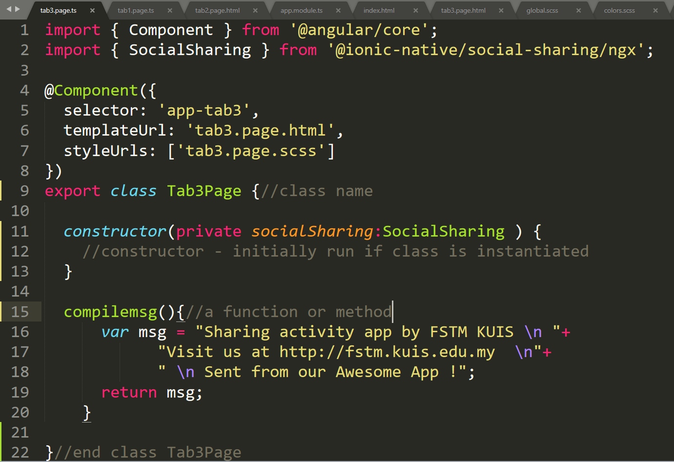
Class Function

Slide 29
Hello World ionic

Slide 30
1. Start a project
ionic start ionpmj tabs

Slide 31
2. CD into Directory & Run the project
ionic serve

Slide 32
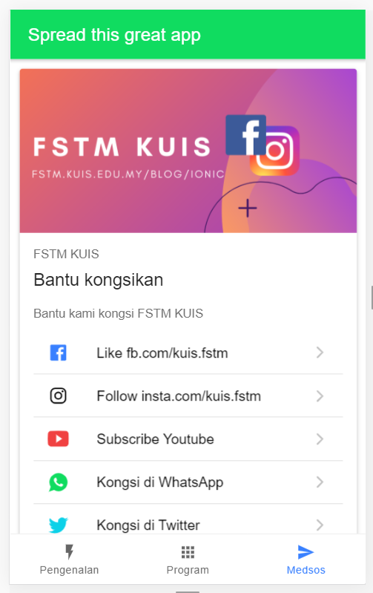
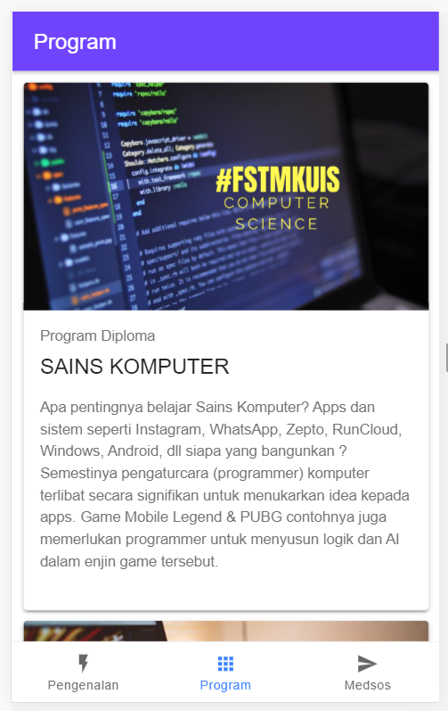
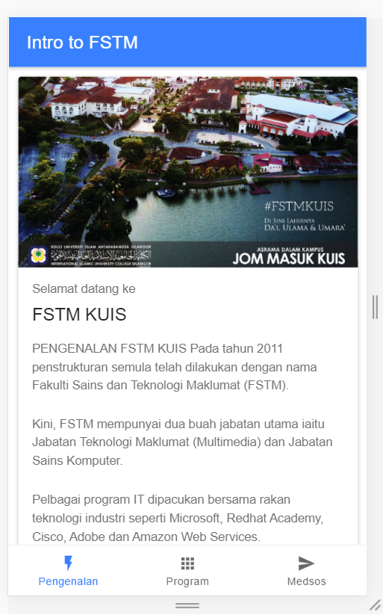
Next tab2 and tab3

Slide 33


T02 HTML interface
(antaramuka)

Slide 34
T02 Antaramuka
HTML
(sambungan bahagian2)

Slide 35
1. Start a project
ionic start appfstm tabs

Slide 36
2. CD into Directory & Run the project
ionic serve

Slide 37
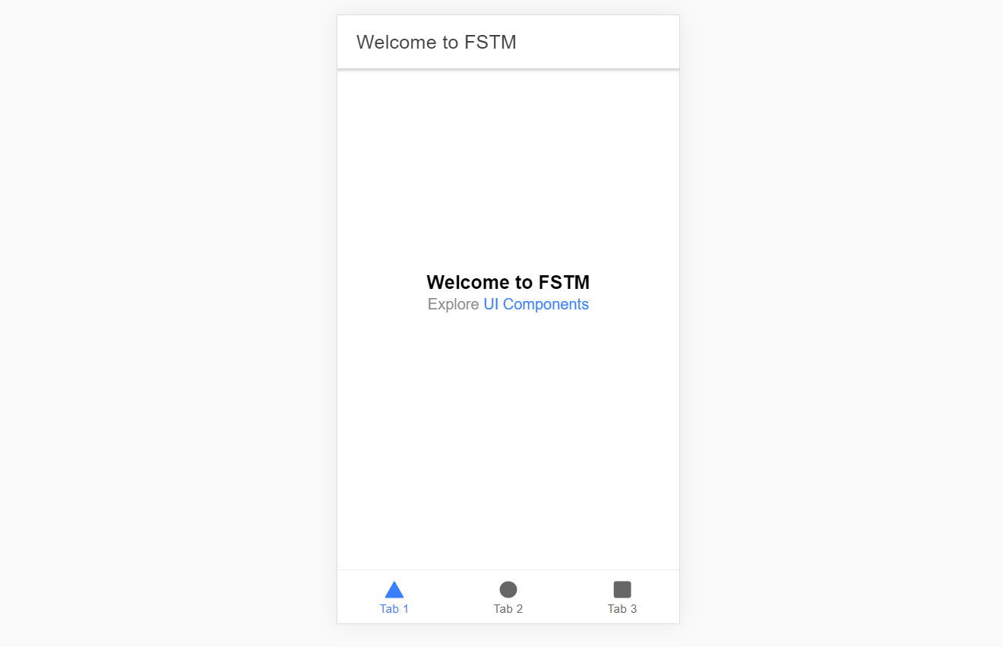
Output : ionic serve

Slide 38
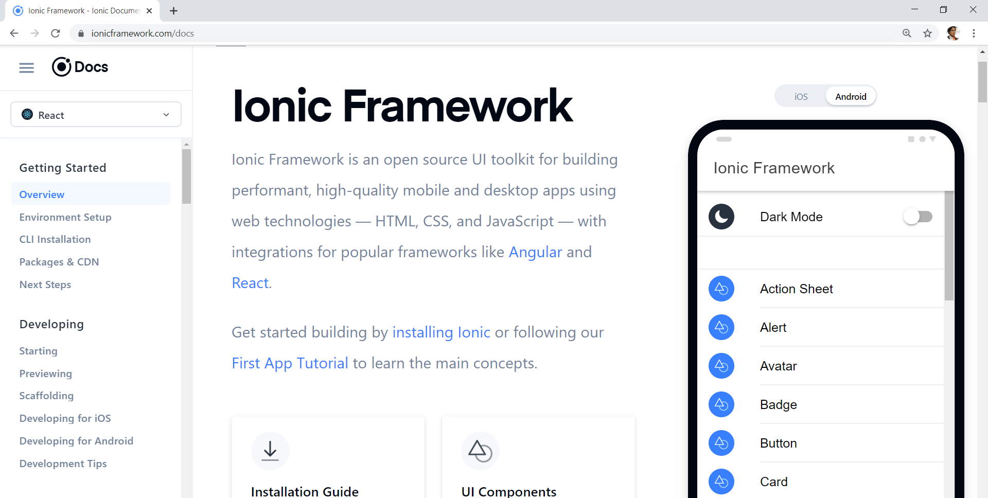
Always refer to documentations: https://ionicframework.com/docs

Slide 39
HTML
-Hyper Text Mark Up Language (HTML)
-Used to display the interface
-Write in tags,
-Example- <strong>Hello</strong> → Hello
-Ionic has its own built in tags
<ion-list></ion-list>
<ion-item></ion-item>
<ion-grid></ion-grid>
-HTML in Ionic is “AngularJS Flavoured”
-Have to use Angular Syntax for data and clicks
-Example- (click), *ngFor etc

Slide 40
CSS or SCSS
-Cascading Style Sheets (CSS)
-Used for styling, very straightforward
-Each generated Ionic page comes with built in own CSS
-Can assist in ‘theming’ the app
-Ionic has standard built in colours
-Primary, Secondary, Danger, Light & Dark
Built in colours that can be added/edited

Slide 41
Next tab2 and tab3

Slide 42
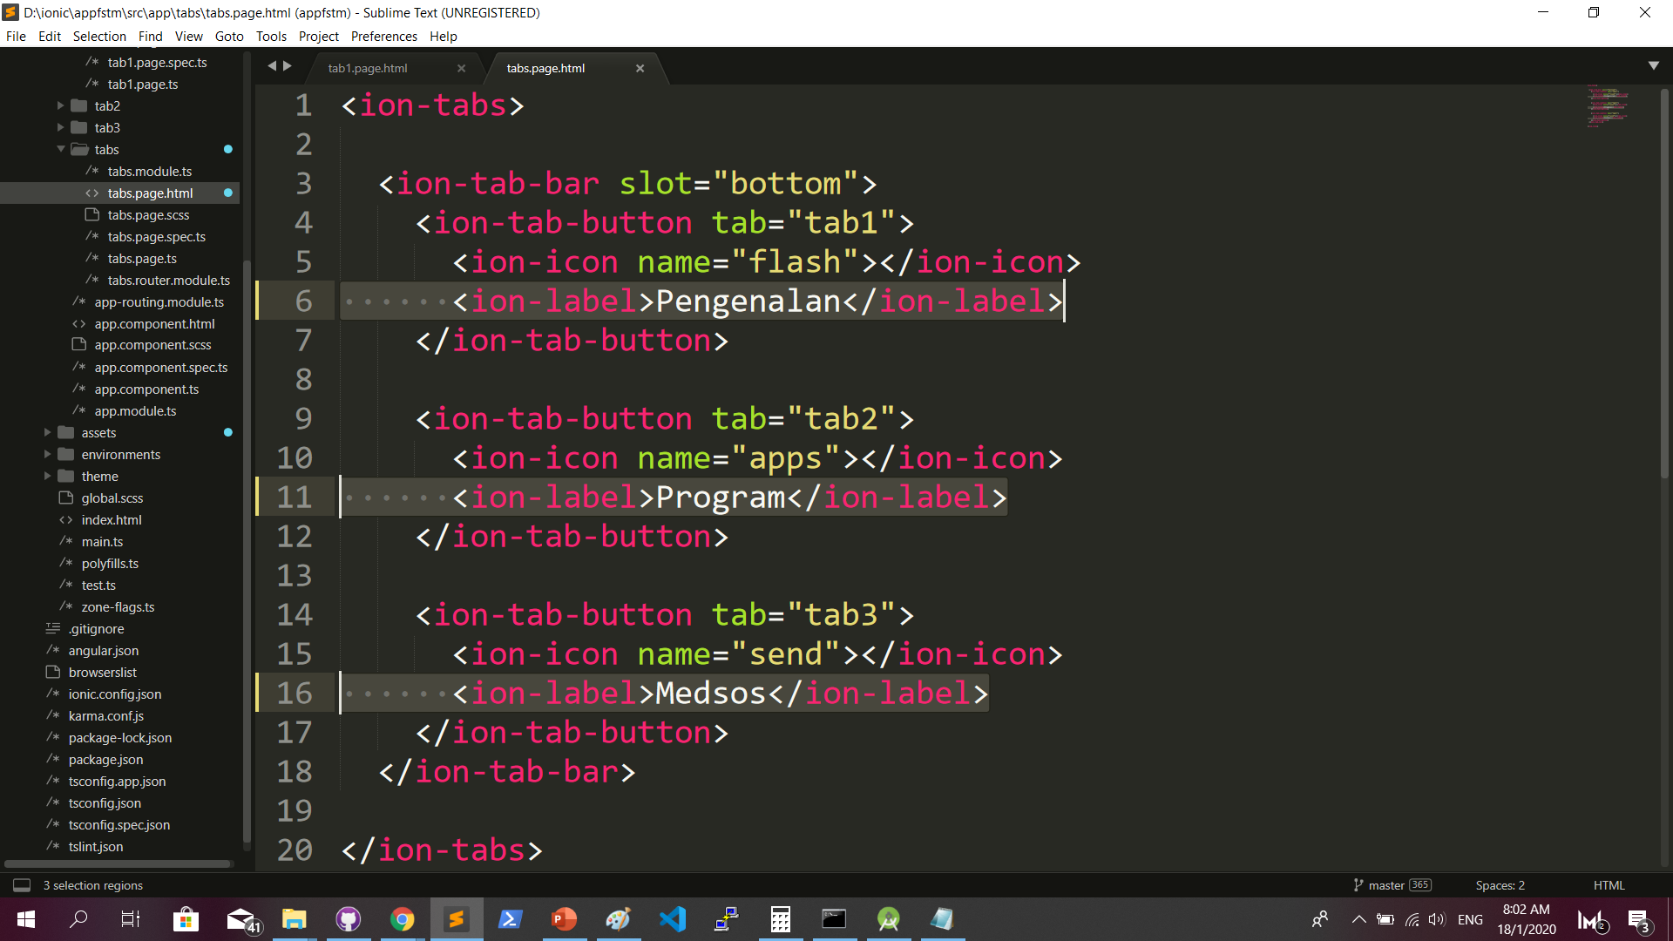
Some interface cosmetics: src/app/tabs/tabs.page.html

Slide 43
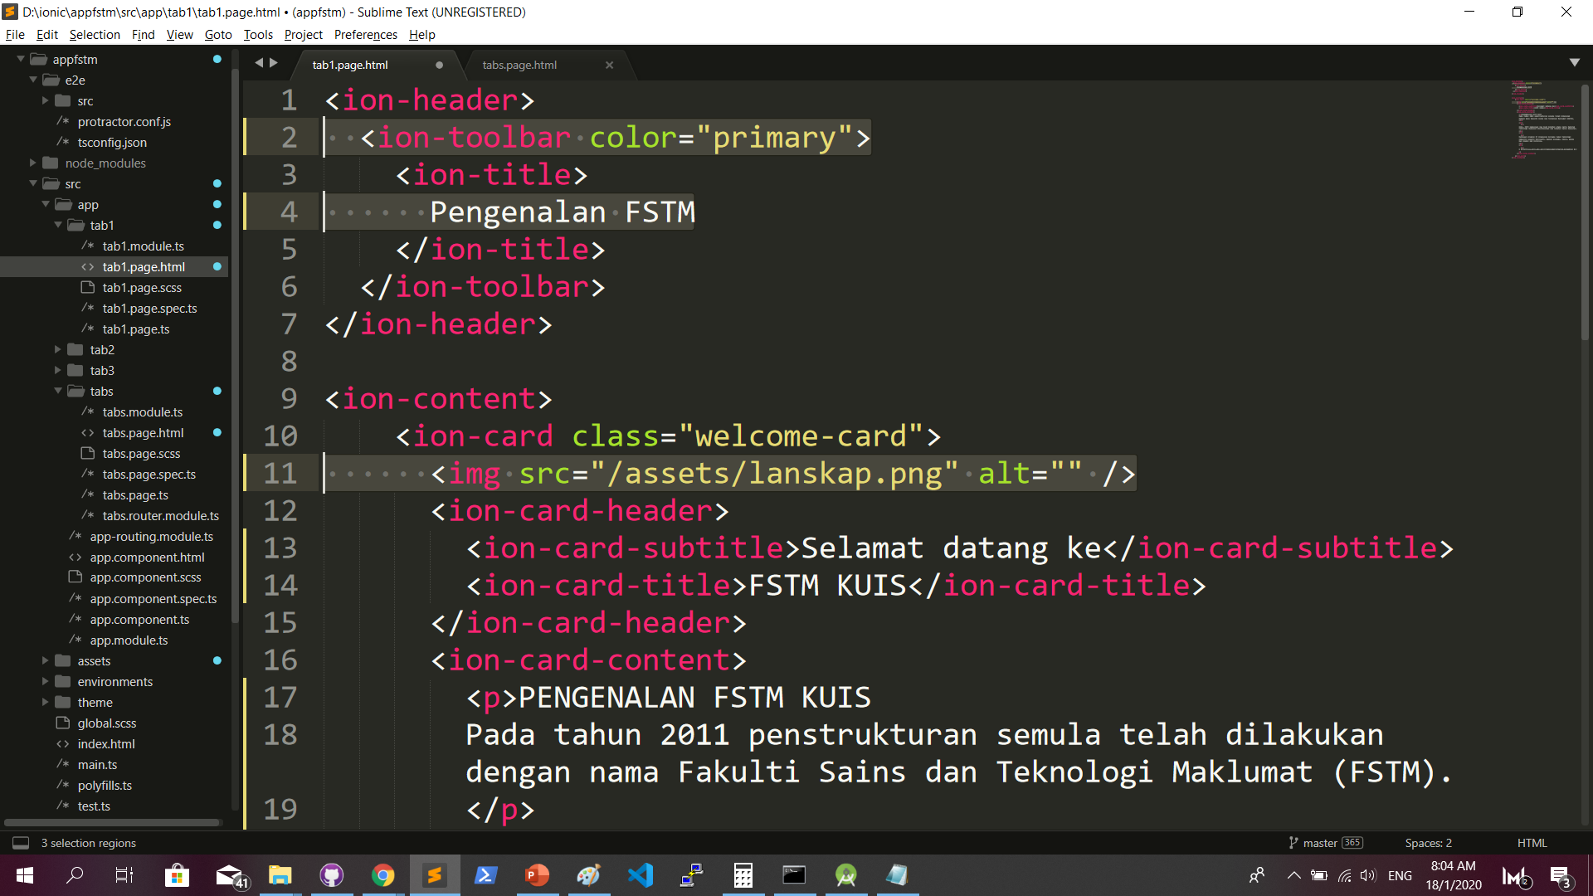
More interface cosmetics: src/app/tab1/tab1.page.html

Slide 44
Run ionic serve

Slide 45
Next tab2 and tab3

Slide 46
Codes & slides github.com/khirulnizam/ionic5

Slide 47
T03 Navigasi
(page navigation)

Slide 48
Page Navigation
+ routerLink (in .html) + NavController (in .ts)

Slide 49
routerLink in HTML
PAGE 1
PAGE 2
See app-routing.module.ts for page name

Slide 50
Exercise : Link to new page
Generate new pages
ionic g page info
ionic g page form

Slide 51
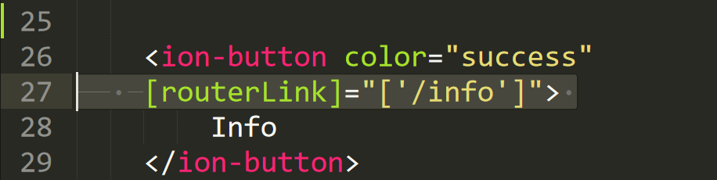
Exercise : Link to new page

Slide 52
NavController in TS
PAGE 1
PAGE 2
See app-routing.module.ts for page name

Slide 53
Add simple form interaction
+ Form Button + Alert function

Slide 54
Try building a button and make an alert
helloWorld(){
alert(“Hello Ionic!”)
}
<ion-button (click)=”helloWorld()”> ALERT </ion-button>
info.page.ts
info.page.html

Slide 55

Codes & slides github.com/khirulnizam/ionic5

Slide 56

T04 TypeScript

Slide 57
TypeScript
-A subset of Javascript
-Part of ECMA6 standard
-The ‘brains’ behind your app
-Used for processing & handling data
Example- calculation, accessing DB etc
-Ionic has standard built in to its TS:
NavController, ModalController etc

Slide 58
Typescript Syntax : Function
n1:number;
n2:number;
output:any;
addnumbers(){
output=n1+n2;
displayresult( );
}
displayresult( ){
alert(“Output: ”+output);
}

Slide 59
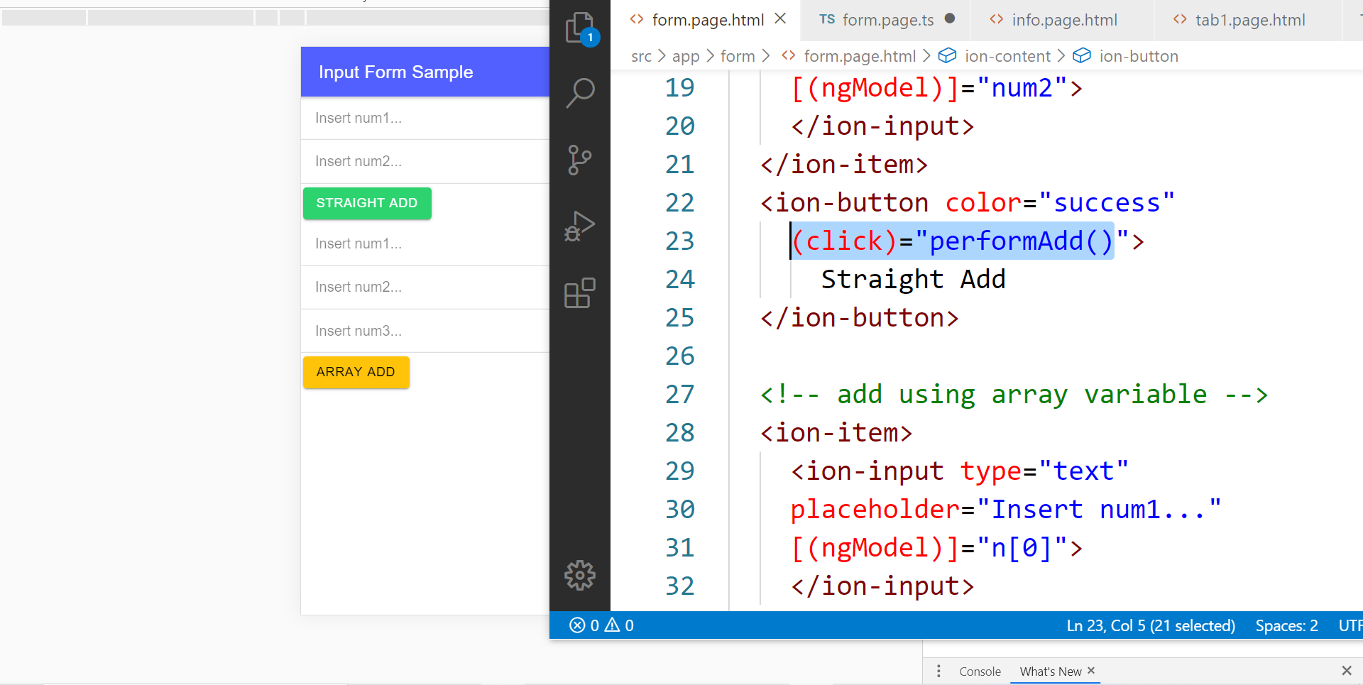
In file .HTML

Slide 60
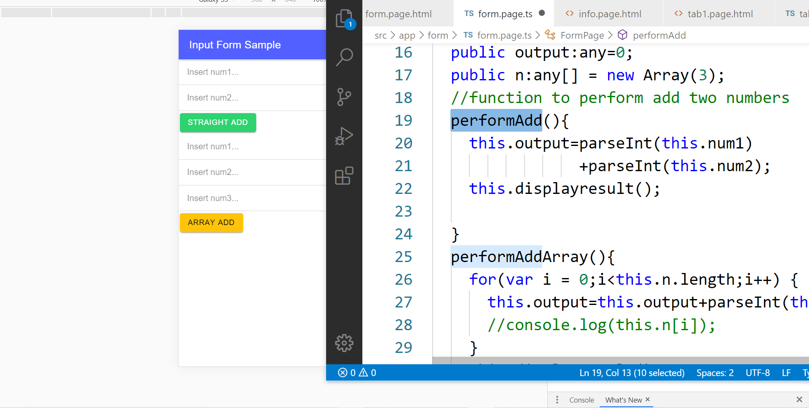
In file .TS

Slide 61
TypeScript Syntax : EX1 variable
What is a variable?
A variable acts as a container for values in a programming code.
var pi:number = 3.14;
Var num1:number=5;
var name:string =“enKerul”;
Use any to loosely-type the variable data type.
Data types:
any
can be numbers or strings
string
“this is string ” + “ concat ”
number
Double 3.14, or integer 5
array
can be a collection of Var, Strings or Objects

Slide 62
Typescript Syntax : EX2 String manipulation & Casting
//to convert String to number
var str = "54";
//easy way by using + operator
var num = +str; var num = parseInt(str);
String manipulation?
var str:string = "3.14";
var pi:number = 3.14;
console.log("pi is "+pi);
console.log("tau is "+(2 * pi));

Slide 63
Typescript Syntax : EX3 Array
Array? Array
can be a collection of Var, Strings or Objects
// A list literal.
var numbers = [4, 1, 5, 6, 3, 2];
for(var i=0;i<numbers.length; i++)
{
sum=sum+numbers[i]);
console.log(“Sum: ”+sum);
}
-----
Output
Sum: 21

Slide 64
Typescript Syntax : EX4 Associative array
Associative Array?
Array with key and value pairs (not index number).
// A map literal.
// Asociative array
var gases = [
'He': 'Helium',
'Ne': 'Neon',
'Ar': 'Argon’,
];
console.log(gases['Ne’]);
-------------------------
Output: Neon

Slide 65



T05 Kamera (installing camera plug-ins)

Slide 66
Codes & slides github.com/khirulnizam/ionic5

Slide 67
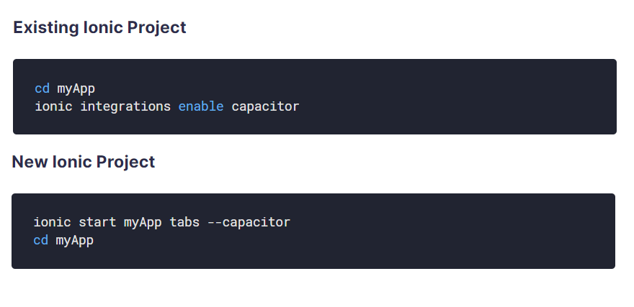
Using Capacitor with Ionic

Slide 68
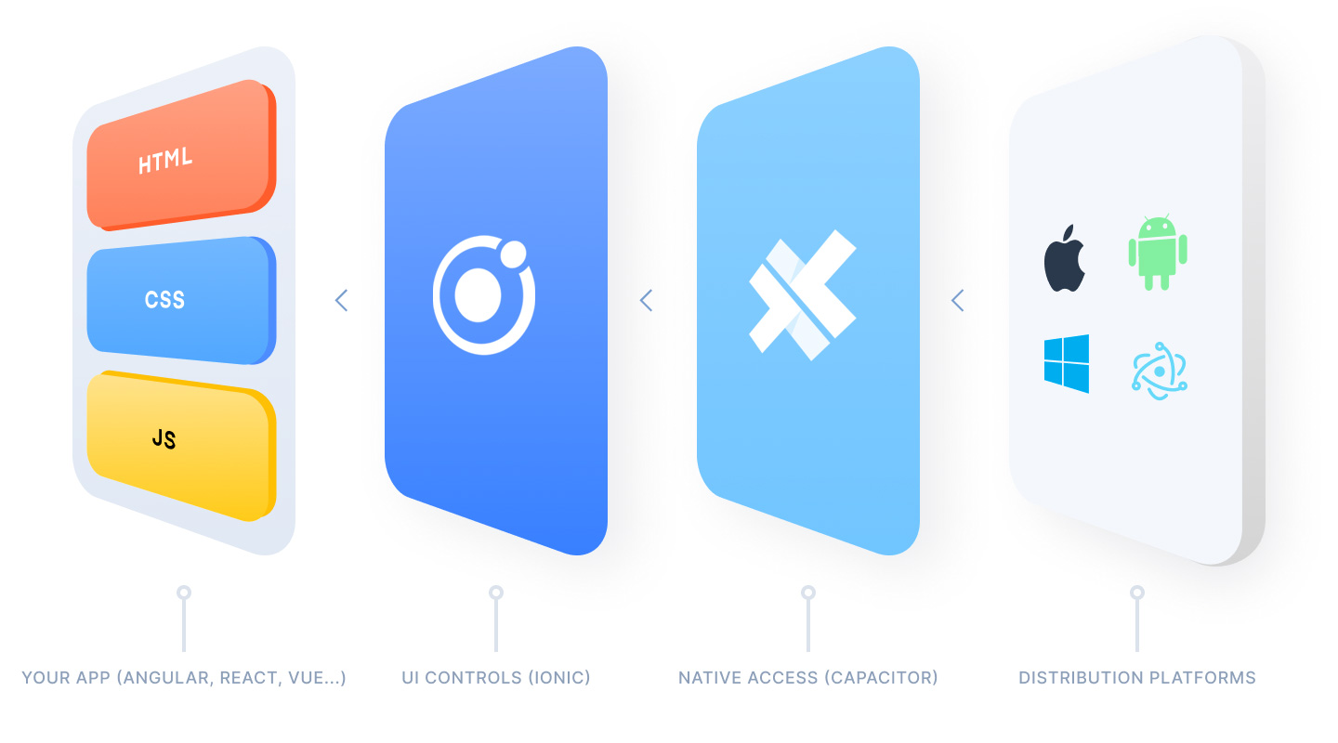
Ionic Capacitor
https://ionicframework.com/resources/articles/capacitor-vs-cordova-modern-hybrid-app-development
runs modern Web Apps natively on iOS, Android, Electron, and Web

Slide 69
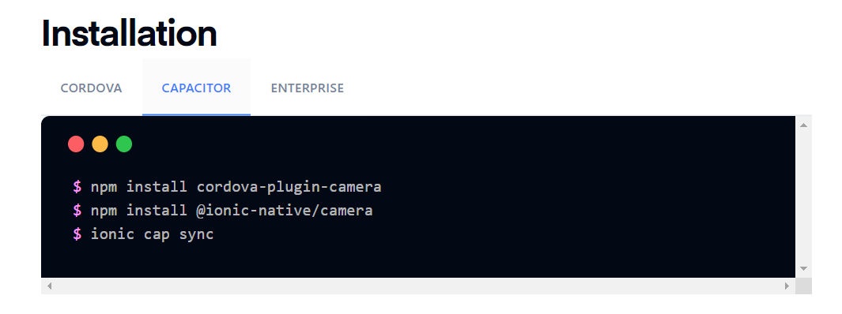
Install camera support : ionicframework.com/docs/native/camera

Slide 70
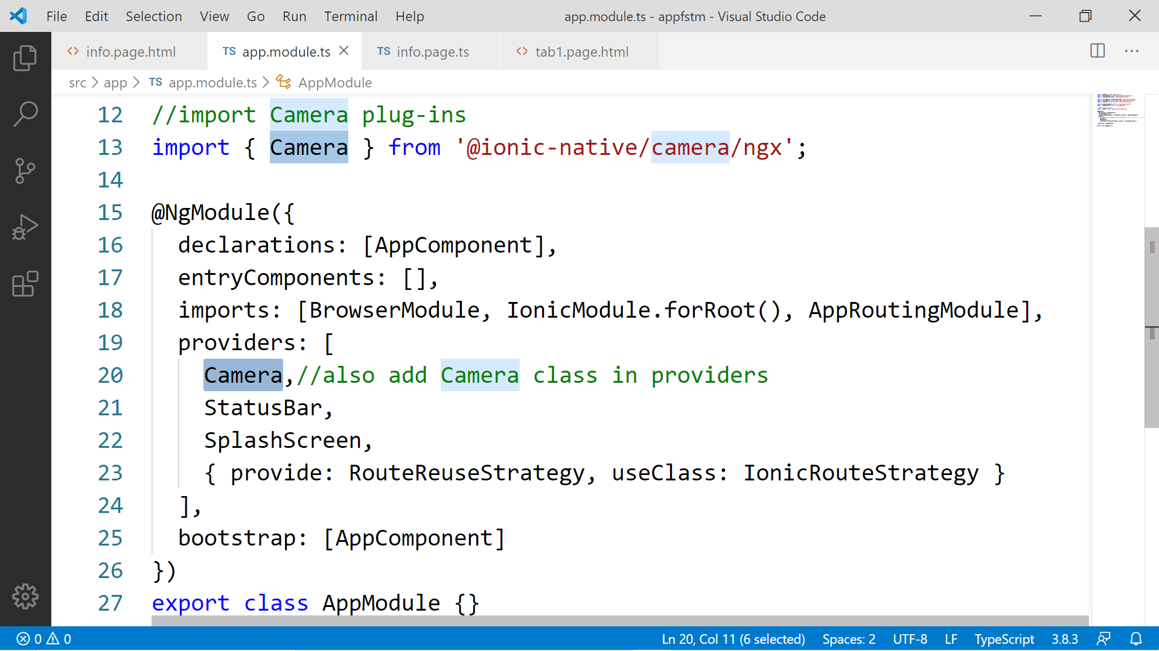

Slide 71
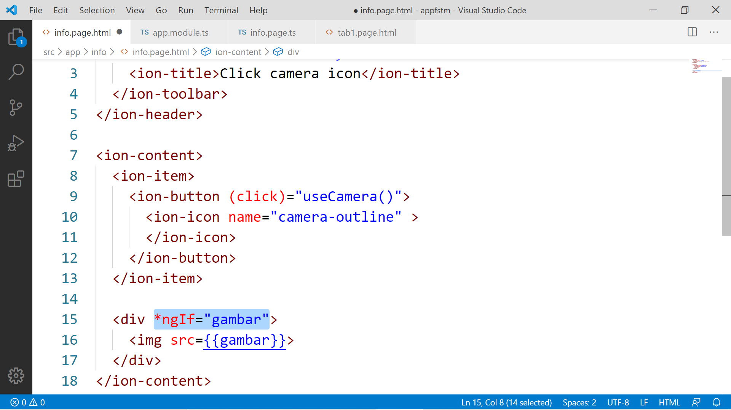

Slide 72
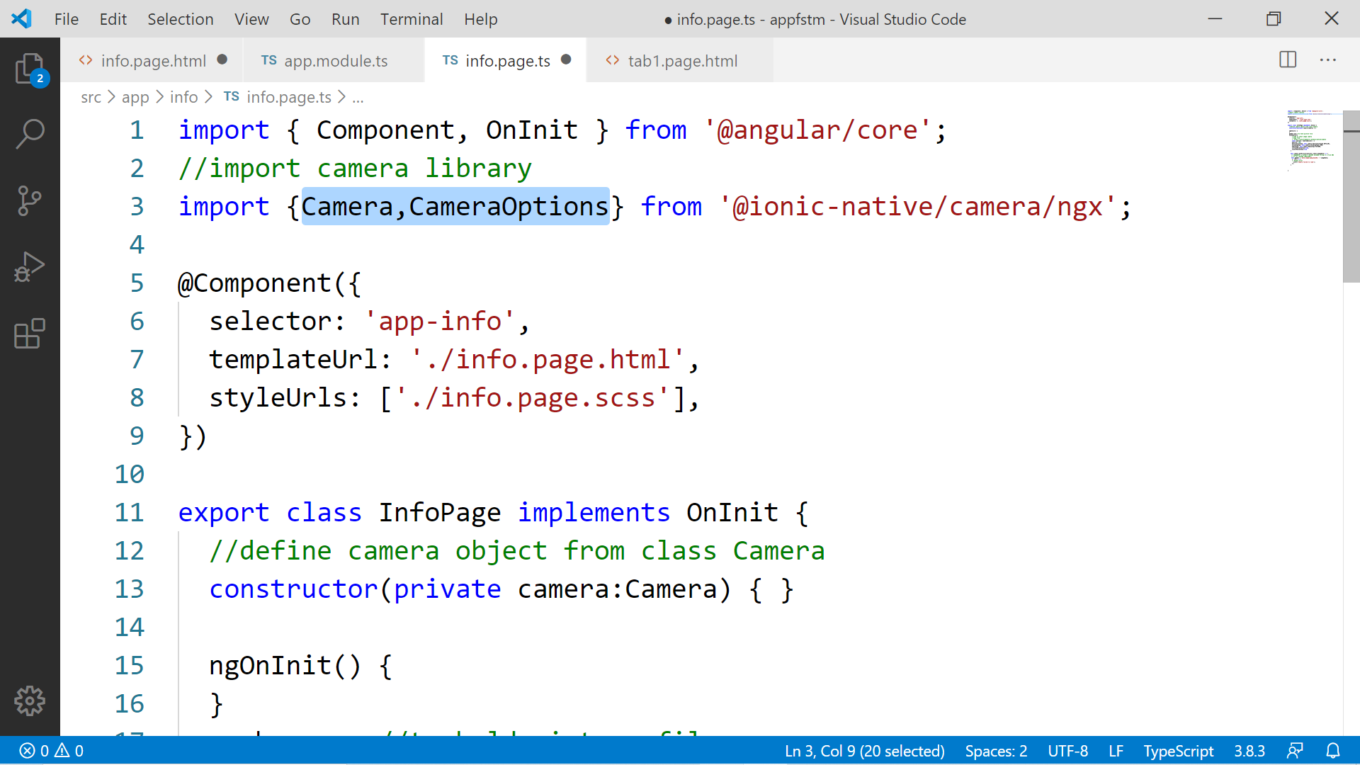

Slide 73
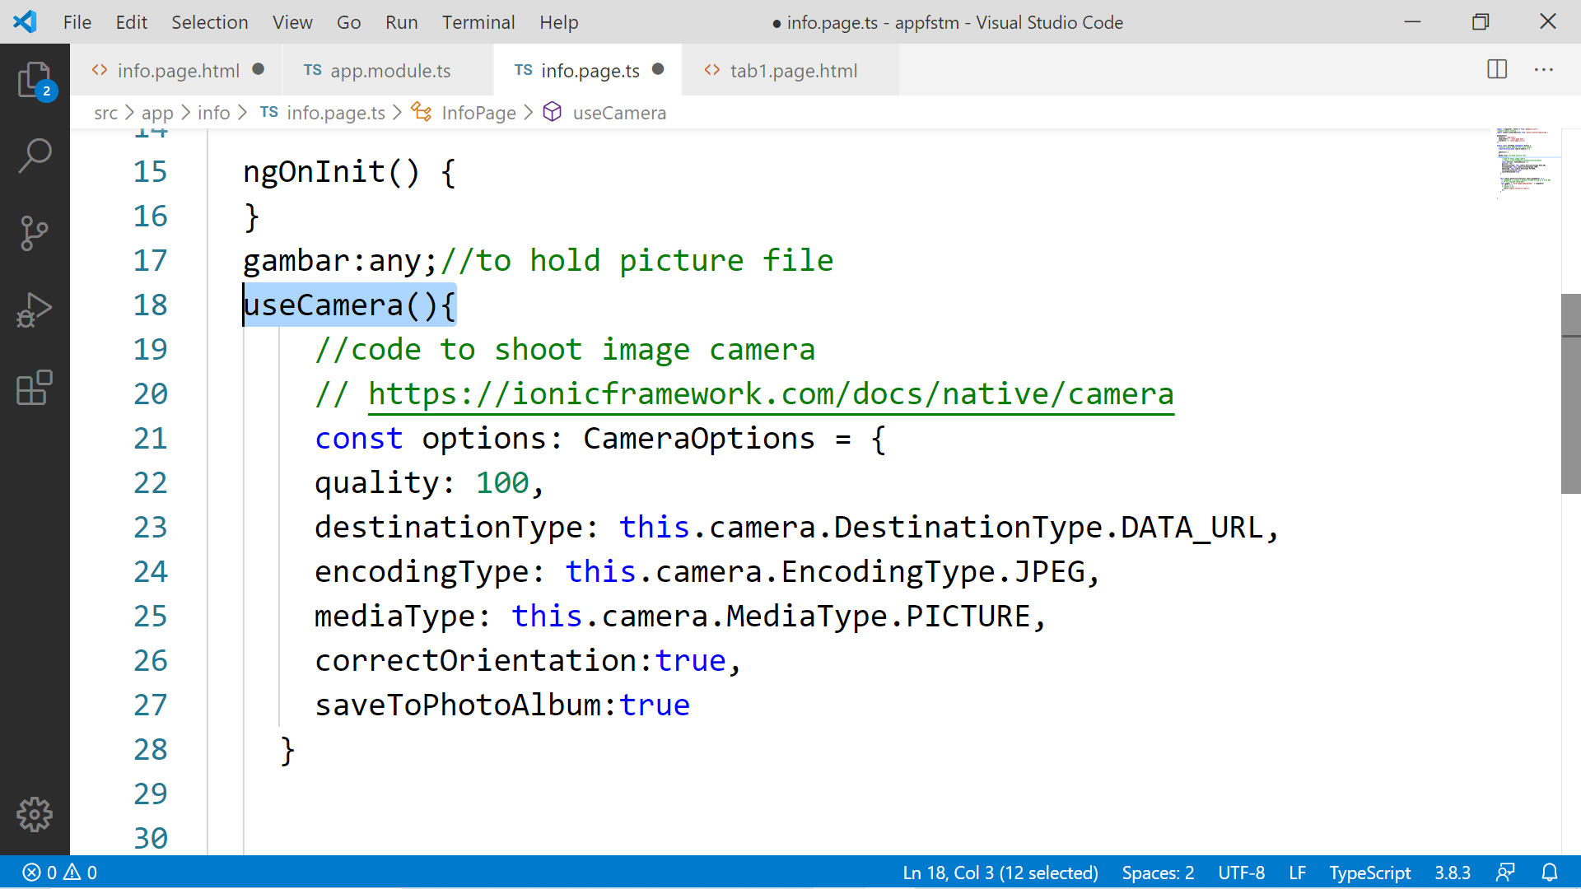

Slide 74
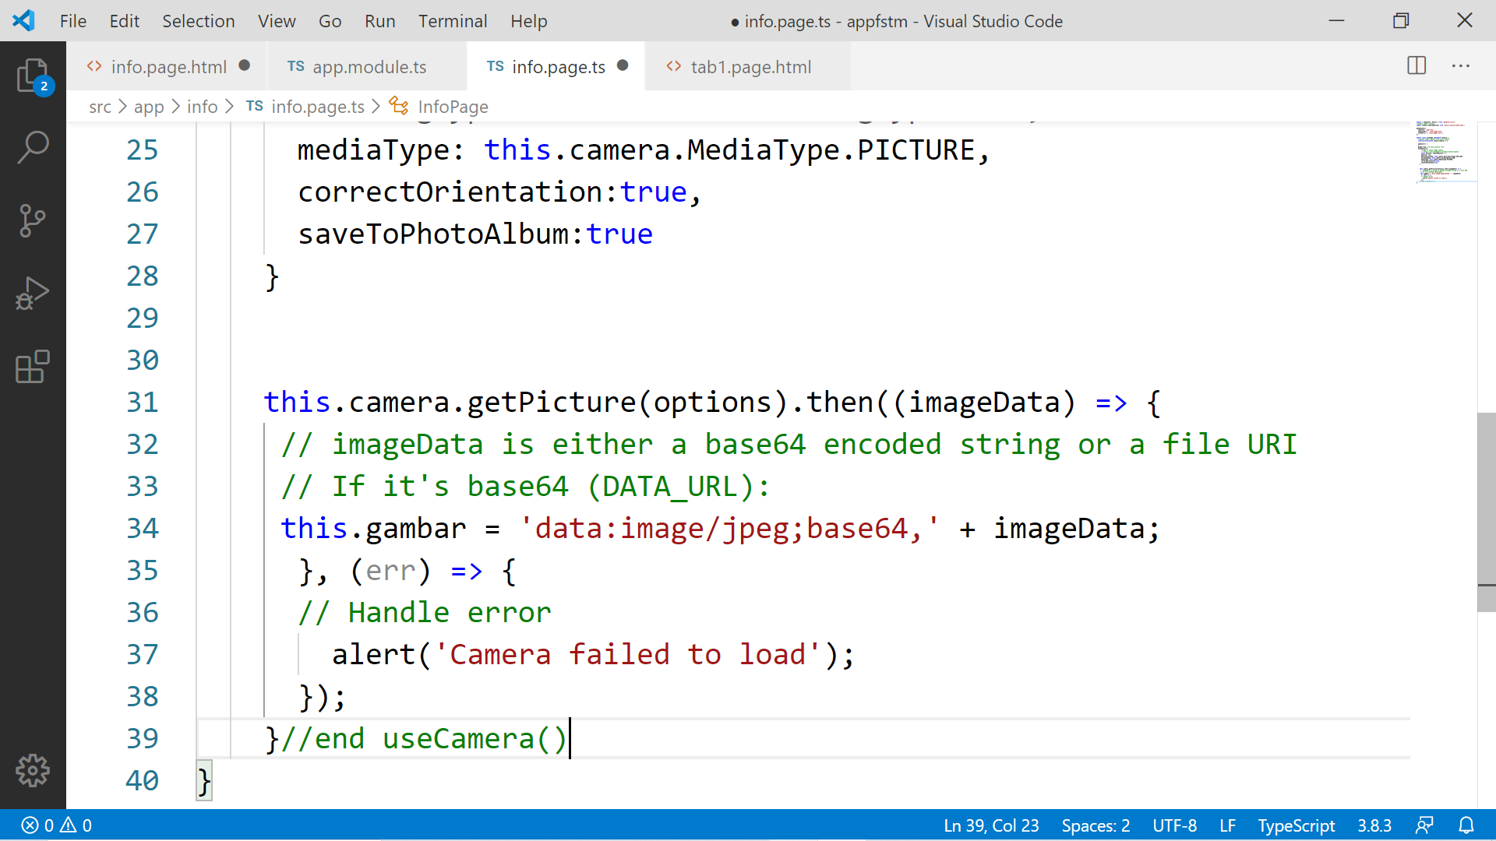

Slide 75
Migration Cordova to Capacitor - error: package android.support.v4.content does not exist
npm install jetifier
npx jetifier
npx cap sync android

Slide 76
Ionic Capacitor
https://ionicframework.com/resources/articles/capacitor-vs-cordova-modern-hybrid-app-development
runs modern Web Apps natively on iOS, Android, Electron, and Web

Slide 77
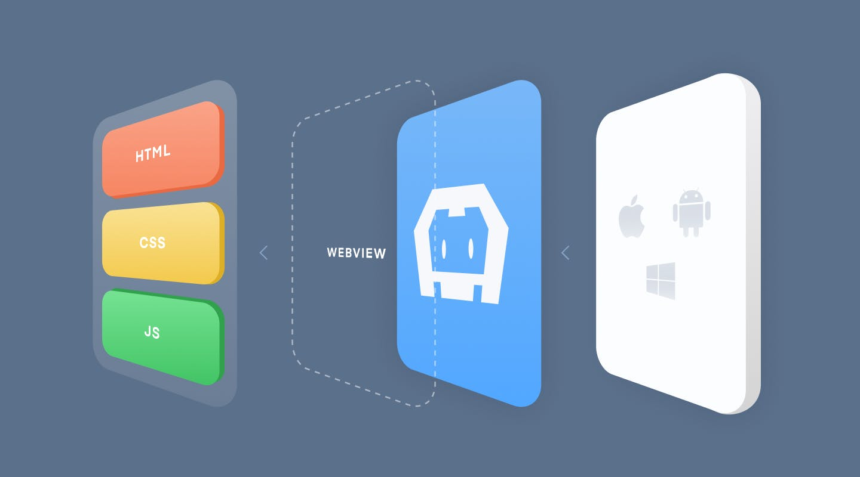
Previously we have CORDOVA

Slide 78
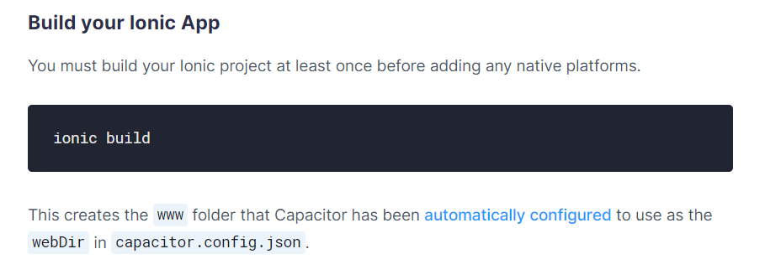
Ionic build

Slide 79
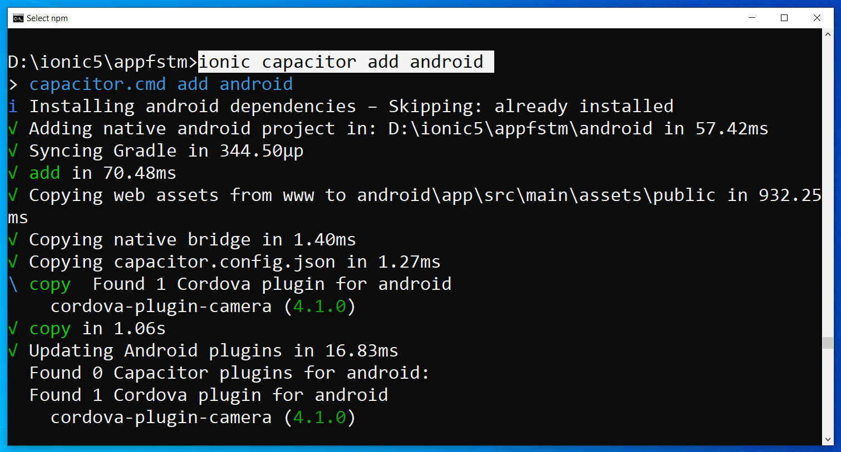
Run only once for each ionic project
To update Android project, execute
ionic build
npx cap copy

Slide 80
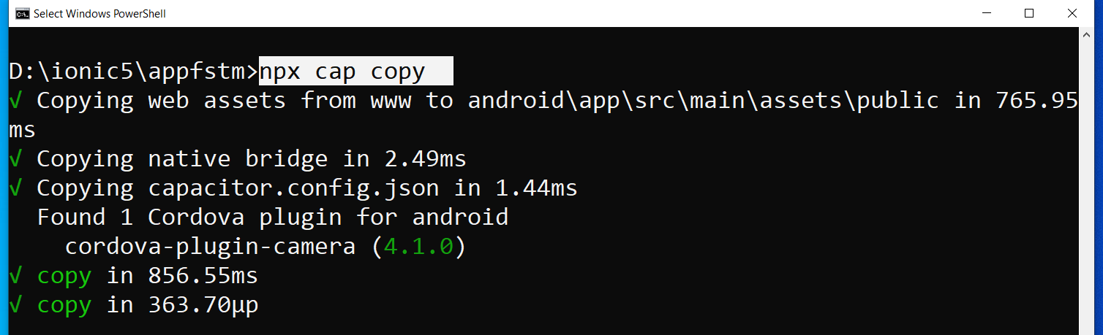
After finish installing the camera plug-ins

Slide 81
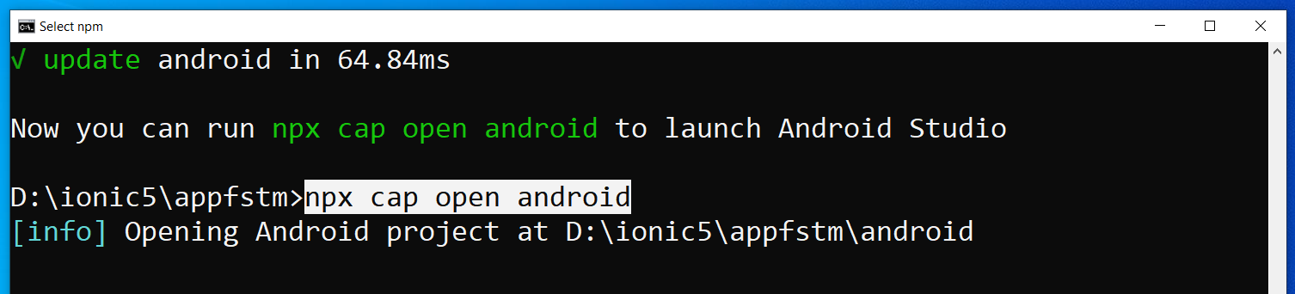
To open project on Android Studio

Slide 82
Codes & slides github.com/khirulnizam/ionic5

Slide 83
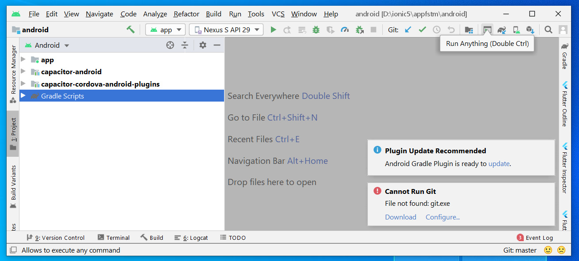
Open in Android Studio

Slide 84
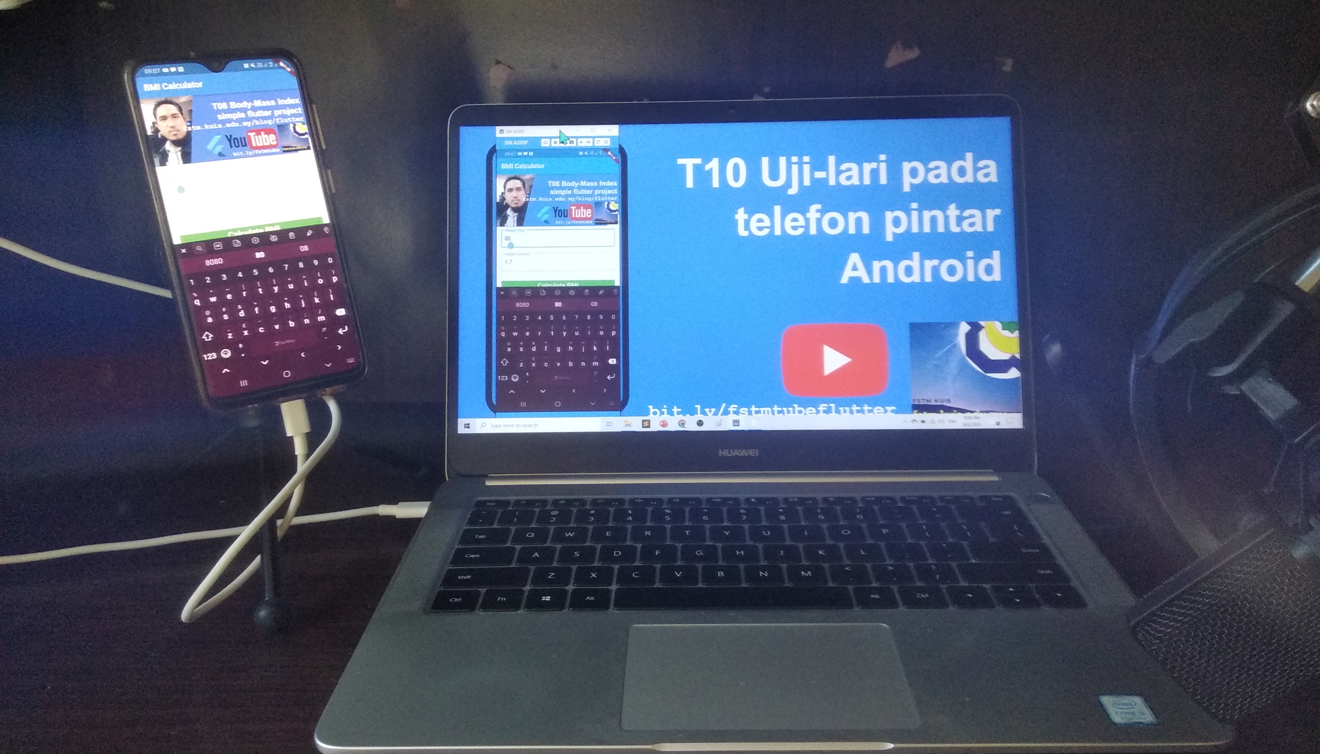


Uji-lari
apps pada
telefon
Android

Slide 85

Android Studio 3.6 & SDK developer.android.com/studio

Slide 86
Path settings (environment variables)
ANDROID_SDK_ROOT
JAVA_HOME

Slide 87
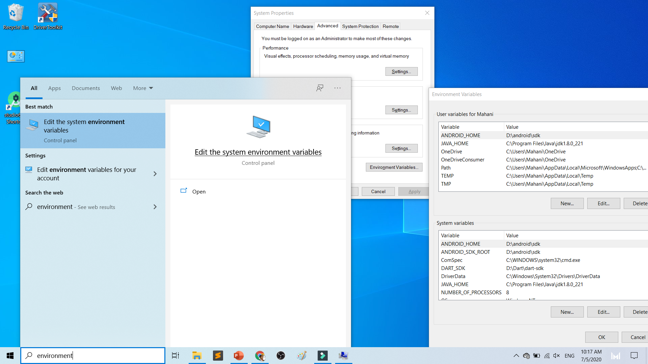

Slide 88
To deploy
Android Studio
Android SDK
Android Phone with USB Debugging enabled
ADB Bridge
USB Data-cable for Actual Device

Slide 89
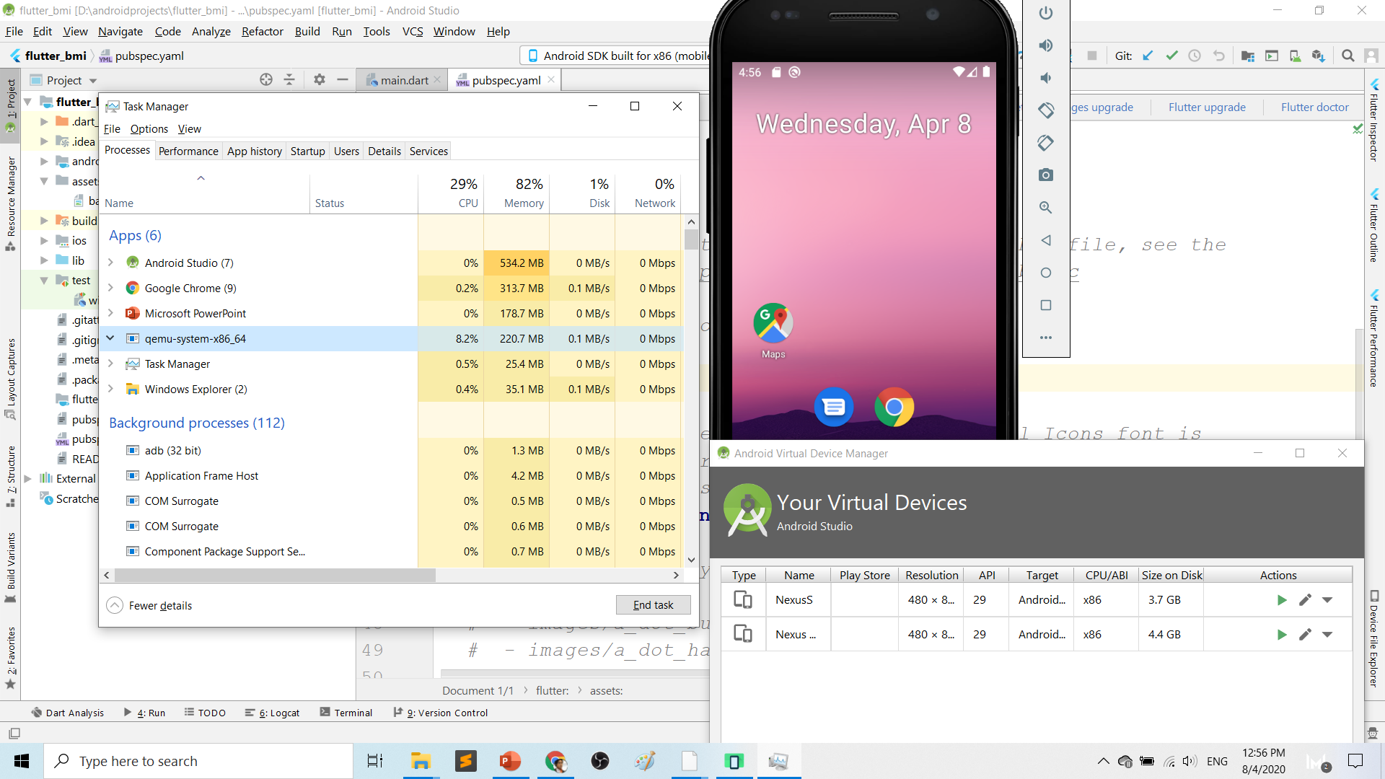
Play.google.com
What’s wrong with Android Studio & Emulator? RESOURCE-HUNGER

Slide 90
Requirements 1. USB debugging ON- phone 2. Connect USB Cable 3. Install ADB driver in PC

Slide 91
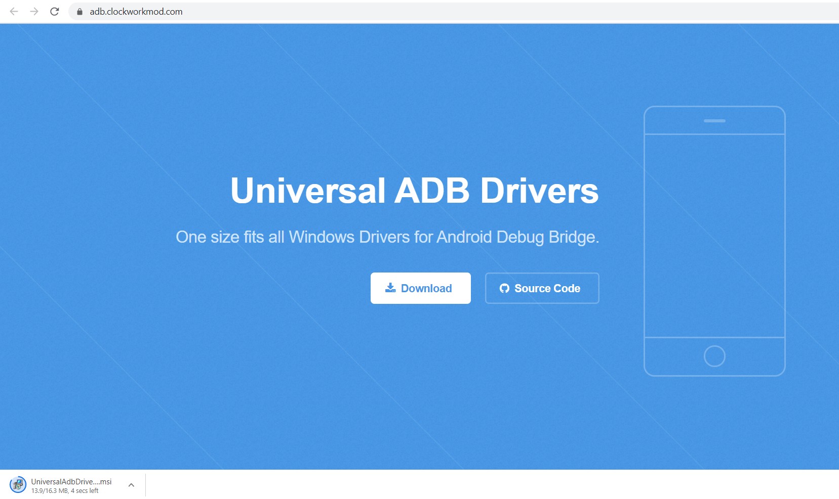
Play.google.com
Install universal debug driver
https://adb.clockworkmod.com/
Download & install universal debug

Slide 92
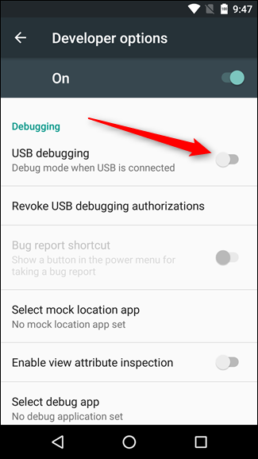
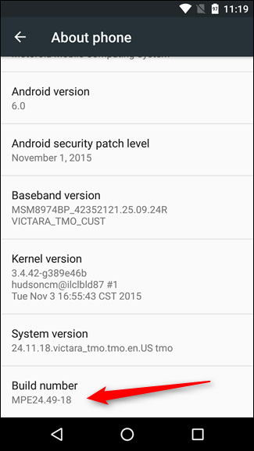
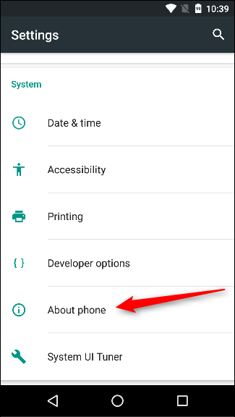
First time to on USB Debugging?
Developer options enable
Press 7X on build number
press 7x

Slide 93
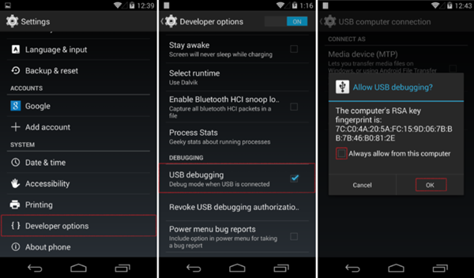
First time Allow USB debugging?

Slide 94
Ionic build

Slide 95
Create Android project/platform ionic capacitor add android
Run only once for each ionic project
To update Android project, execute
ionic build
npx cap copy

Slide 96
Copy to www to android project npx cap copy

Slide 97
To open project on Android Studio npx cap open android

Slide 98
Open in Android Studio

Slide 99
Codes & slides github.com/khirulnizam/ionic5

Slide 100


T07 Pilihan Selection : if…else, ngIf
Codes & slides
github.com/khirulnizam/ionic5

Slide 101
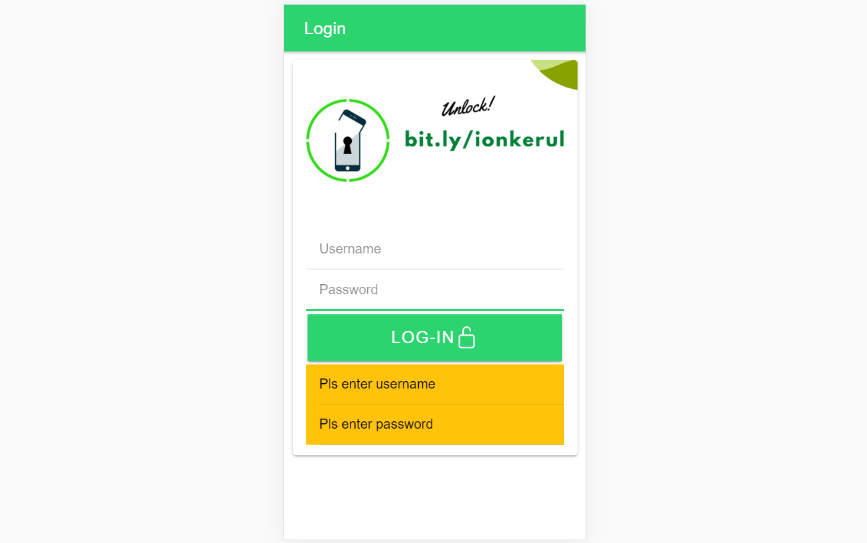
Output overview

Slide 102
Create a new page
ionic g page login
(selection exercise)

Slide 103
[(ngModel)]
Example:
IN TYPESCRIPT:
username:any;
password:any;
IN HTML:
<ion-input [(ngModel)]= “username”>
</ion-input>
<ion-input [(ngModel)]= “password”>
</ion-input>
[(ngModel)] USED IN HTML to capture what is typed into input to TypeScript

Slide 104
*ngIf used in HTML
Usually used for array iterations
Example:
IN HTML
<div *ngIf= “ username==null ”>
Pls enter username
</div>
<div *ngIf= “ password==null ”>
Pls enter password
</div>
*ngIf USED IN HTML

Slide 105
*ngIf … else used in HTML
<div *ngIf="gambar; else noImageYet">
<img src="{{gambar}}">
</div>
<ng-template #noImageYet>
<img src="./assets/noimagep.png">
</ng-template>
*ngIf … else USED IN HTML

Slide 106
IF...ELSE IF...ELSE AND *ngIFStatements
Usually used for selection and/or filtering
Example:
if(username== null){
alert(“Pls insert username”);
}
else if(password==null){
alert(“Pls insert password”);
}
else {
alert(“Welcome user”);
}
IF...ELSE IF..ELSE USED IN TYPESCRIPT IS EXACTLY THE SAME AS JAVASCRIPT

Slide 107
Output

Slide 108

T08 Ulangan Repetition : for, foreach, ngFor

Slide 109
Codes & slides github.com/khirulnizam/ionic5

Slide 110
Create a new page
ionic g page irepeat
(repetition exercise)

Slide 111
For Loop and *ngFor
Usually used for array iterations. Example:
negeri[0]= “Johor”;
negeri[1]= “Melaka”;
negeri[2]= “N. Sembilan”;
negeri[3]= “Selangor”;
for(var x=0;x<negeri.length;x++)
{
console.log(negeri[x]);
}
This will output in the console all the items in the array
FOR LOOP USED IN TYPESCRIPT

Slide 112
For Loop and *ngFor
Usually used for array iterations
Example:
IN TYPESCRIPT
negeri[0]= “Johor”;
negeri[1]= “Melaka”;
negeri[2]= “N. Sembilan”;
negeri[3]= “Selangor”;
IN HTML
<ion-item *ngFor= “let item of negeri”>
{{ item }}
</ion-item>
This will output all the negeris in HTML
*ngFor LOOP used in HTML

Slide 113

T09 Navigasi (navigation with parameters)

Slide 114
PARAMETERS
PAGE 1
(irepeat)
PAGE 2
(displayparams)
Nama: Kerul
Poskod: 43000
Negeri: Selangor
Nama: Kerul
Poskod: 43000
Negeri: Selangor
Nama: Kerul
Poskod: 43000
Negeri: Selangor

Slide 115
Navigation with Parameters
1. Using Router
TO SEND VALUES (CANNOT SEND OBJECTS)

Slide 116
2. Using Services
Navigation with Parameters
*TO SEND OBJECTS

Slide 117
Using ActivatedRoute
On app-routing.module.ts add param name, example /:id
Add /id when navigating
To get param
import {Router} from ‘@angular/router’
public route:Router
let the_id=this.route.snapshot.params.id

Slide 118
Using Services

Slide 119
USING SERVICES
HOME
SERVICES:
Functions
createUser(email, password)
{
…
}
loginUser(){
…
}
listUsers(){
…
}
DAFTAR
LOGIN
OTHER SERVICES

Slide 120
Using SERVICES
Services can be used globally
Can be used repeatedly
By different pages/other services

Slide 121
Generate a service
ionic g service service/data
Import Service and call from page ts

Slide 122


Slide 124


shareMasjid

Slide 125

& Firestore Auth

Slide 126


t10 Firebase (setup)

Slide 127

github.com/khirulnizam/ionic5 wasap.my/60129034614

Slide 128

Serverless option using Firebase
Serverless computing is a method of providing backend services on an as-used basis
A Serverless provider allows users to write and deploy code without the hassle of worrying about the underlying infrastructure
Scalable - the serverless vendor handles all of the scaling on demand
Simplified backend code
Quicker turnaround

Slide 129

JSON Concept
JSON: JavaScript Object Notation.
JSON is a lightweight data-interchange format
JSON format is text only, it can easily be sent to and from a server.

Slide 130
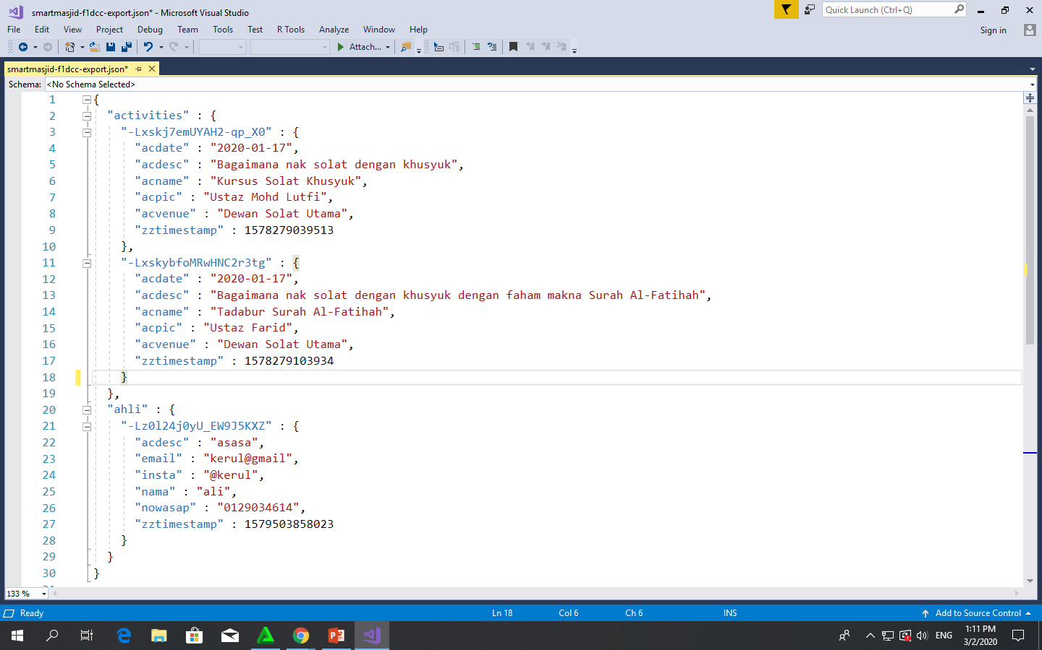
Play.google.com
JSON format example as applied in Firebase

Slide 131
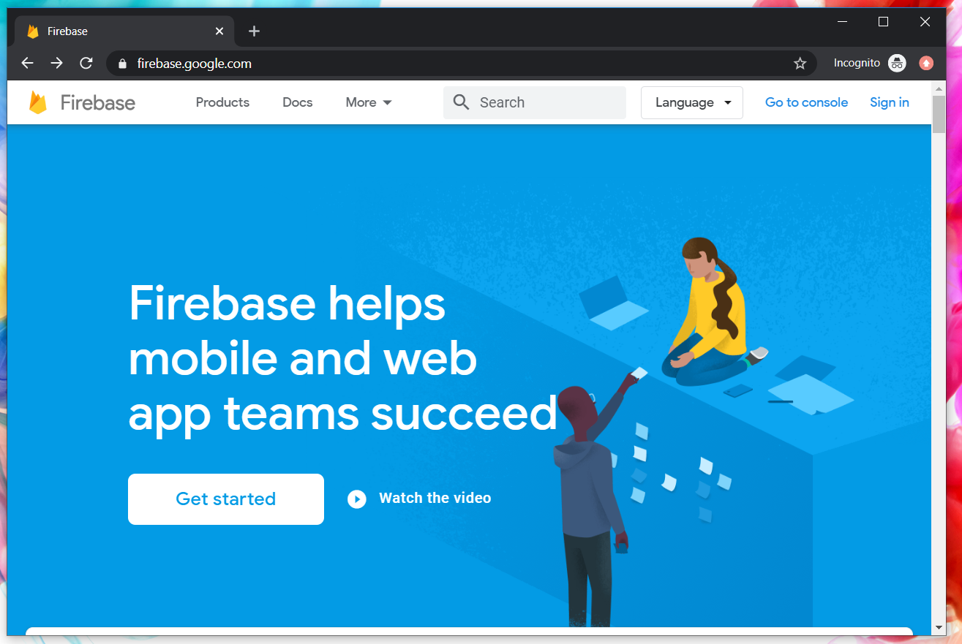
Google Firebase : Console
https://console.firebase.google.com/

Slide 132
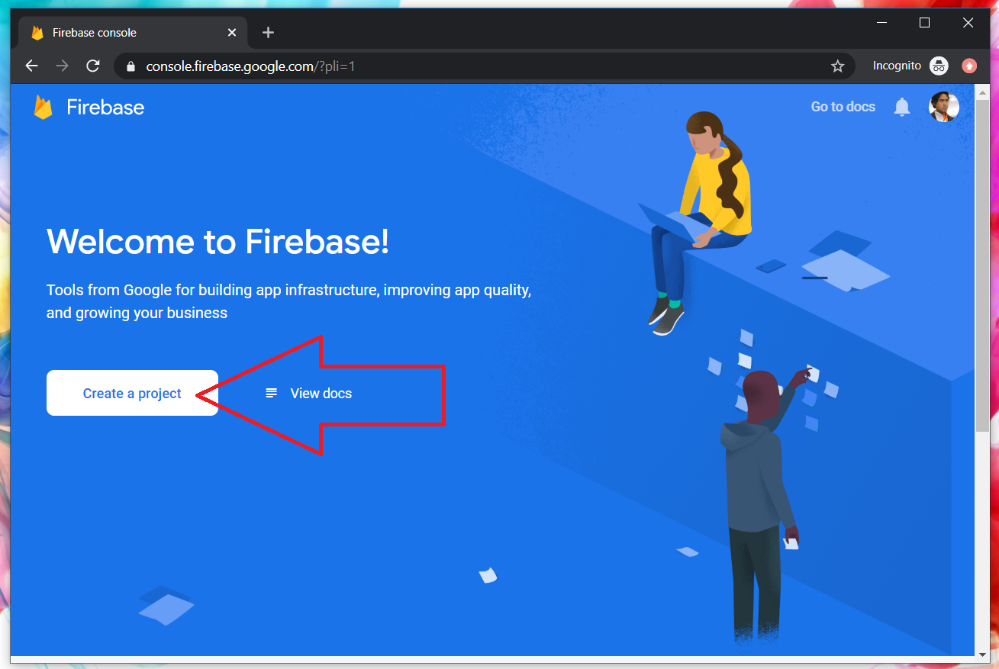
Google Firebase : Create new project

Slide 133
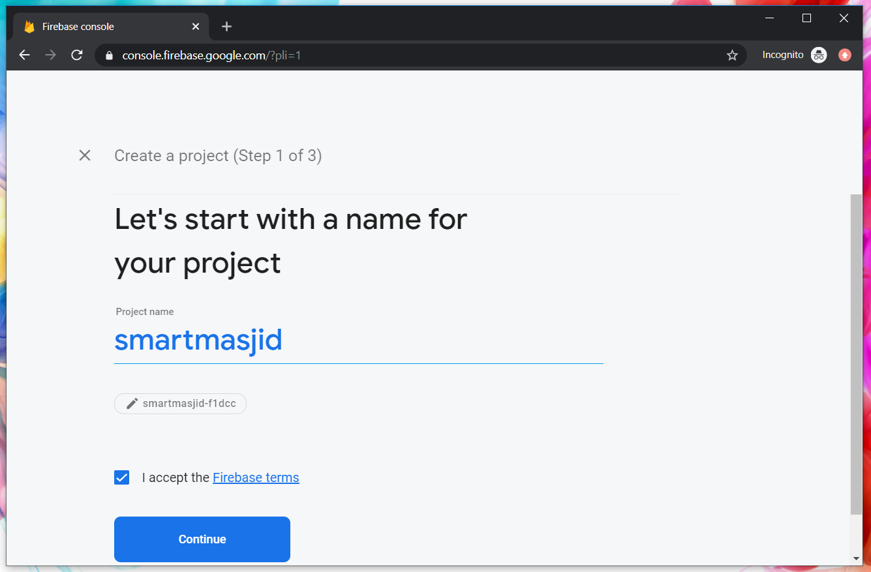
Google Firebase : Project name
sharefstm

Slide 134
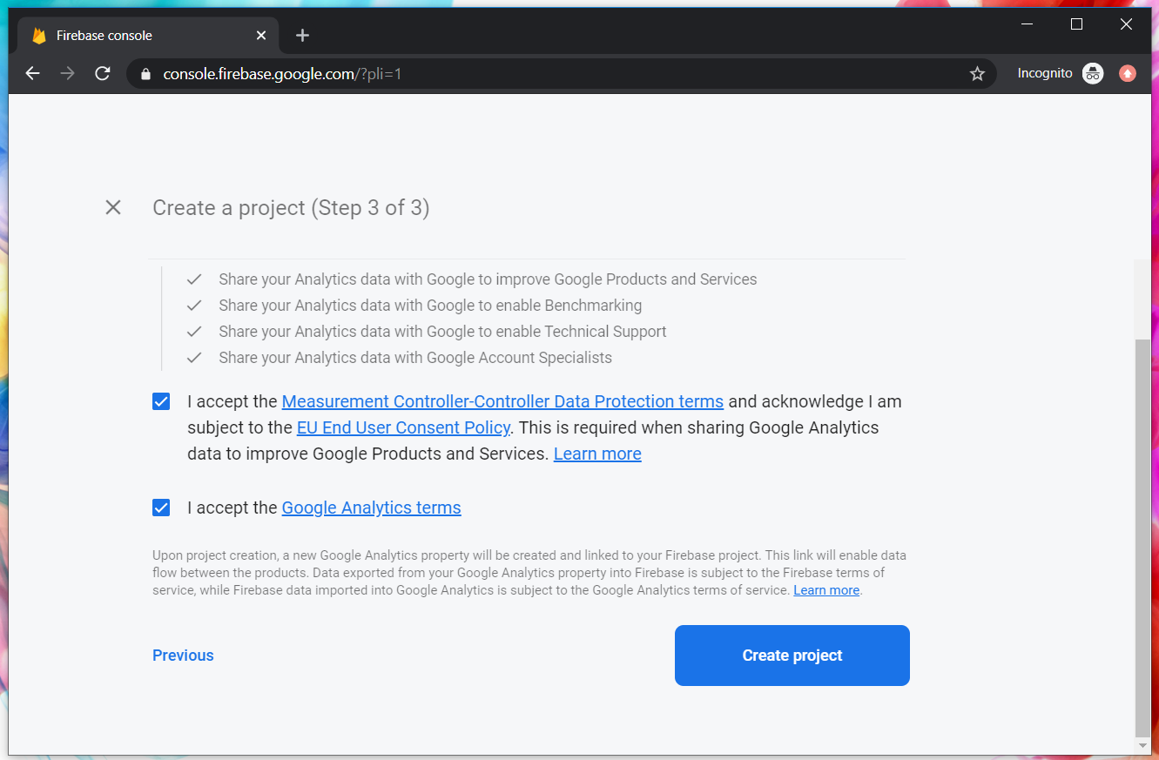
Google Firebase : Accept T&C

Slide 135
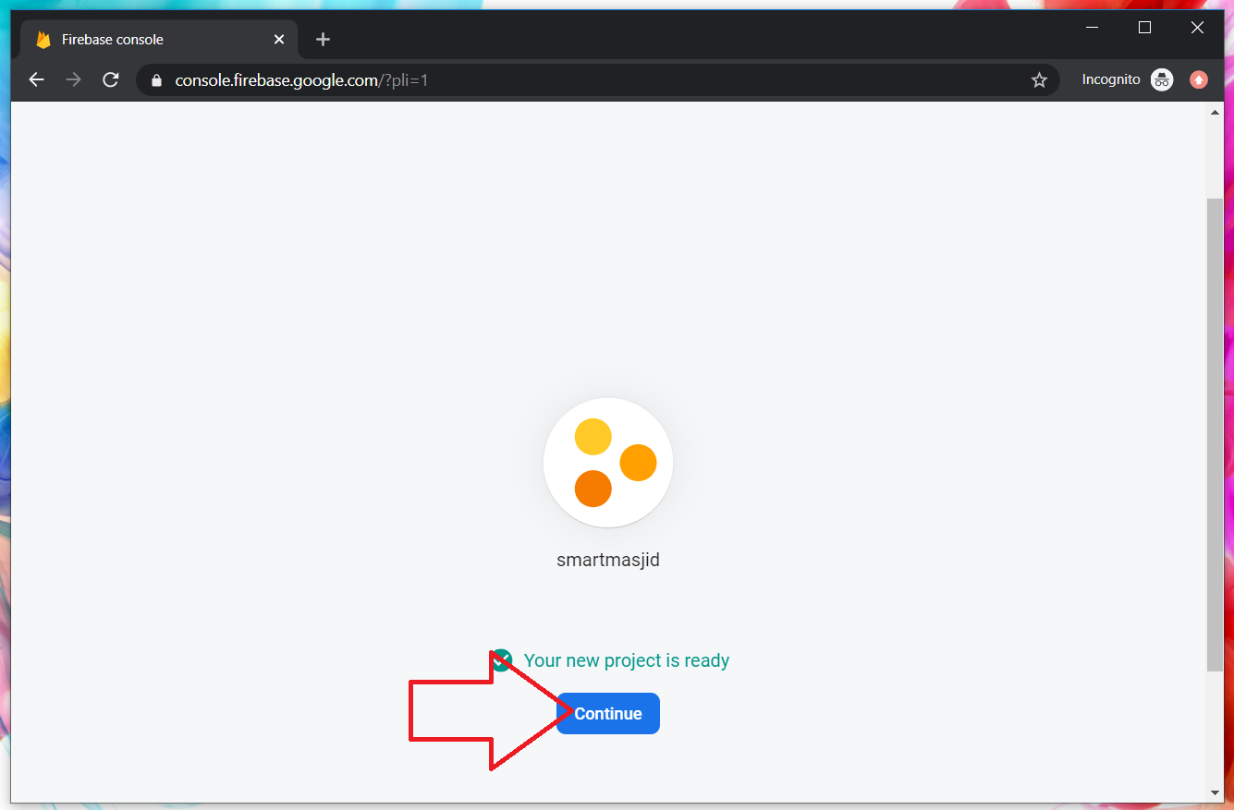
Google Firebase : Project ready and continue
makanapps

Slide 136
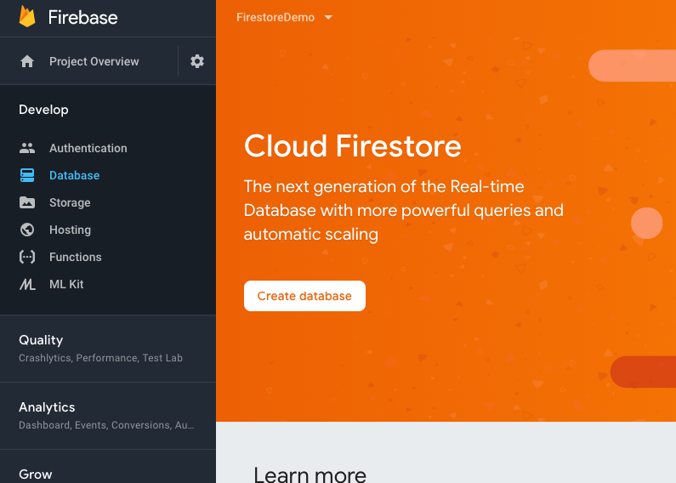
Google Firebase : Realtime database, automatic scaling

Slide 137
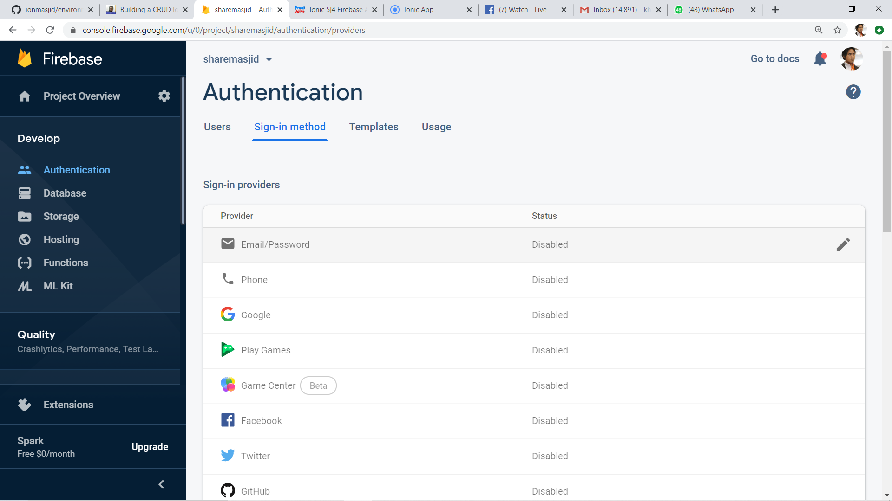
2
1
3

Slide 138

1
2

Slide 139

Google Firebase : Enable test mode

Slide 140

Google Firestore : add Firebase to app

Slide 141

Web Apps Firebase Configuration : Copy the highlighted

Slide 142

T11 Auth + Register
(daftar pengguna)

Slide 143

Create new Ionic project
ionic start sharefstm blank
Page 1: home

Slide 144

Filename src/app/home/home.page.html

Slide 145
Paste the Firebase configuration to environtment.ts
In environment.ts
…
export const environment : {
production: false,
firebaseConfig: {
apiKey: "AIzXXXXXXXXXXXXXXXWZMPN90HFrp4",
authDomain: "test-projeXXXXXXX.firebaseapp.com",
databaseURL: "https://test-projeXXXXXXX.firebaseio.com",
projectId: "test-projeXXXXXXX7",
storageBucket: "test-projeXXXXXXXX.appspot.com",
messagingSenderId: "446XXXXXX105"
}
};
…

Slide 146
Install AngularFirebase plugins
npm install firebase @angular/fire --save

Slide 147
Filename src/app/app.module.ts
//src/app/app.module.ts
…
//firebase & auth
import { AngularFireModule } from '@angular/fire';
import { AngularFireAuthModule } from '@angular/fire/auth';
import { environment } from '../environments/environment';
…
imports: [BrowserModule, IonicModule.forRoot(), AppRoutingModule,
//firebase & auth
AngularFireAuthModule,
AngularFireModule.initializeApp(environment.firebaseConfig),
…

Slide 148
Create globally accessible functions in folder services
ionic g service services/firebase
import { AngularFireAuth } from '@angular/fire/auth';
…
export class FirebaseService {
constructor(
private afAuth: AngularFireAuth
) { }
registerUser(email, password) {
return new Promise<any>((resolve, reject) => {
this.afAuth.createUserWithEmailAndPassword(email, password)
.then(
res => resolve(res),
err => reject(err))
})
}

Slide 149

Add another page
ionic g page daftar
Page 2: daftar

Slide 150

Filename src/app/daftar/daftar.page.html

Slide 151

Filename src/app/daftar/daftar.page.html

Slide 152

Filename src/app/daftar/daftar.page.ts

Slide 153

Filename src/app/daftar/daftar.page.ts

Slide 154


Slide 155
T12 Auth + Login
(pengesahan pengguna)

Slide 156
github.com/khirulnizam/ionic5 wasap.my/60129034614

Slide 157
Add globally accessible functions in folder services
ionic g service services/firebase
import { AngularFireAuth } from '@angular/fire/auth';
…
loginUser(email, password) { //function loginUser
return new Promise<any>((resolve, reject) => {
//authenticating with email & password
this.afAuth.signInWithEmailAndPassword(email, password)
.then(
res => resolve(res), //successful
err => reject(err)) //rejected
})
}//end loginUser
…

Slide 158

Add another page
ionic g page login
Page 3: login

Slide 159

Filename src/app/login/login.page.html

Slide 160

Filename src/app/login/login.page.html

Slide 161
Filename src/app/login/login.page.ts
…
cubalogin(email, password) {
this.fService.loginUser(this.email, this.password)
.then(res => {
console.log(res);
this.errorMessage = "";
//this.navCtrl.navigateForward('/dashboard');
}, err => {
this.errorMessage = err.message;
})
}//end cubalogin
…

Slide 162
github.com/khirulnizam/ionic5 wasap.my/60129034614

Slide 163




CRUDS

Slide 164

T13 Rekod Baharu
(insert new record)

Slide 165
github.com/khirulnizam/ionic5 wasap.my/60129034614

Slide 166
T14 Papar Senarai Rekod

Slide 167
github.com/khirulnizam/ionic5 wasap.my/60129034614

Slide 168
T15 Carian

Slide 169
github.com/khirulnizam/ionic5 wasap.my/60129034614

Slide 170
T16 Kemaskini
(update record)

Slide 171
github.com/khirulnizam/ionic5 wasap.my/60129034614

Slide 172
T17 Padam
(delete record)

Slide 173
SQLite
Ionic 5 Modals and SQLite Tutorial: Build a Product Manager App | Techiediaries
Ionic SQLite Tutorial - codesundar

Slide 174
JSON Ionic
Ionic 5 HTTP POST with Angular by Example | Techiediaries
Loading Remote JSON Data with HTTP in Ionic | joshmorony - Learn Ionic & Build Mobile Apps with Web Tech

Slide 175

Pengujian apps pada Android Emulator

Slide 176

Download Android Studio https://developer.android.com/studio

Slide 177

File -> New -> New Project

Slide 178

Package name

Slide 179

Tools -> AVD Manager

Slide 180

+ Create Virtual Device

Slide 181

Minimal resolution device

Slide 182

Choose available Android system image

Slide 183

If system image not yet available
Download Android
system image for
1.5GB! (estimation)

Slide 184

AVD name
Click Finish

Slide 185

Run Android Virtual Device

Slide 186

Run
Shift+F10

Slide 187

Apps is
Running
On AVD

Slide 188
Slides & materials github.com/khirulnizam/ionic5

Slide 189


Muatnaik Apps ke
Google Playstore
Fblive FSTM KUIS
11pg 6Nov 2020 (Jumaat)

Slide 190

←App ID

Slide 191

Play.google.com
Register for a developer ID
USD25 for life.
Another consideration: you need to pay through Google Wallet, using a credit card. https://play.google.com/apps/publish/

Slide 192
Playstore Graphic Materials
high-res icon. (size 512px x 512px)
Featured graphic. (size 1024px x 500px)
at least 2 non-Android TV screenshots. (2 screenshot images. Min length for any side: 320px)

Slide 193

Samples of graphic materials & signed bundle/APK

Slide 194
Graphic materials github.com/khirulnizam/ionic5

Slide 195



Slide 196


bit.ly/m-mathurat
(ionic)

Slide 197
https://ionicframework.com/docs/cli/commands/cordova-resources
Graphic materials
resources/icon.png (with size 1024x1024)
resources/splash.png (with size 2732x2732)

Slide 198

https://ionicframework.com/docs/cli/commands/cordova-resources
Graphic materials
resources/icon.png (with size 1024x1024)
resources/splash.png (with size 2732x2732)
(create folder resources)
splash.png
(2732x2732px)
icon.png (1024x1024px)

Slide 199
https://ionicframework.com/docs/cli/commands/cordova-resources
Commands - CLI
ionic cordova resources

Slide 200

Ionic cordova resources
(created after ionic cordova resources)

Slide 201
In file package.json add
"scripts": {
…
"resources":"cordova-res --skip-config --copy",
…
}

Slide 202
ionic capacitor add android
ionic build
npm install jetifier
npx jetifier
npx cap sync android
npx cap open android

Slide 203


Build, copy and open in Android Studioclz
ionic capacitor add android (sekiranya belum)
ionic build
npx cap sync android
npm install capacitor-resources -g
cordova-res --skip-config --copy
npx cap open android
Run apps in Android Studio
cordova-res to copy icon/splash from resources to Android project res folder

Slide 204



Kursus Perisian Pejabat
FPTT UTEM (online)
30 Dis 2020
Pn Mahani Ma’mum

